Slide 1
GROUP MEETING
2026.1.12

Slide 2
Recent Progress
Key Points
Partial recovery of previously lost data
Some documentation missing, but core scripts restored
Opportunity to re-audit and correct legacy code
Model performance returned to previous baseline

Slide 3
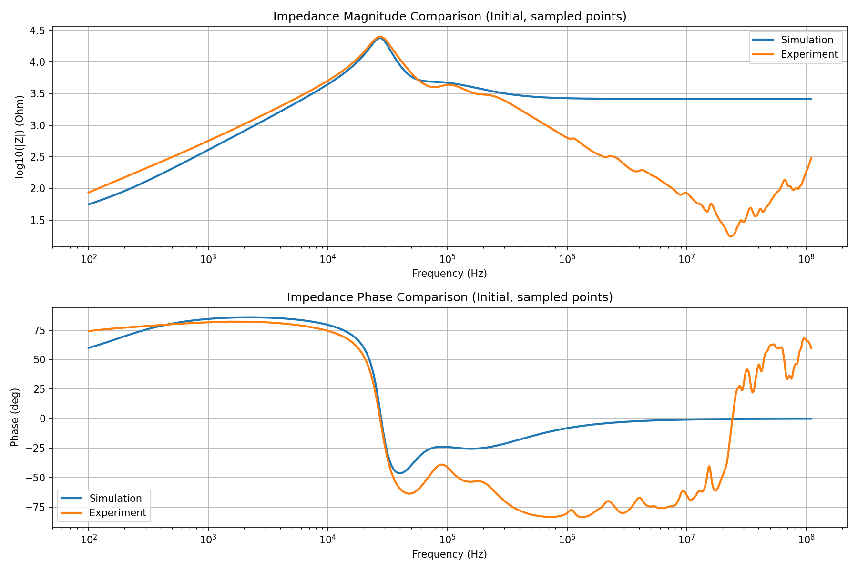
Fitting Strategy Update
Current Approach
Nonlinear Least Squares (NLLS) fitting
Applied mainly in LF–MF range
Notes
Optimization space is still flexible:
  Re-weighting residuals
  Improved frequency sampling
Advanced methods (e.g. NN-based fitting) postponed intentionally

Slide 4
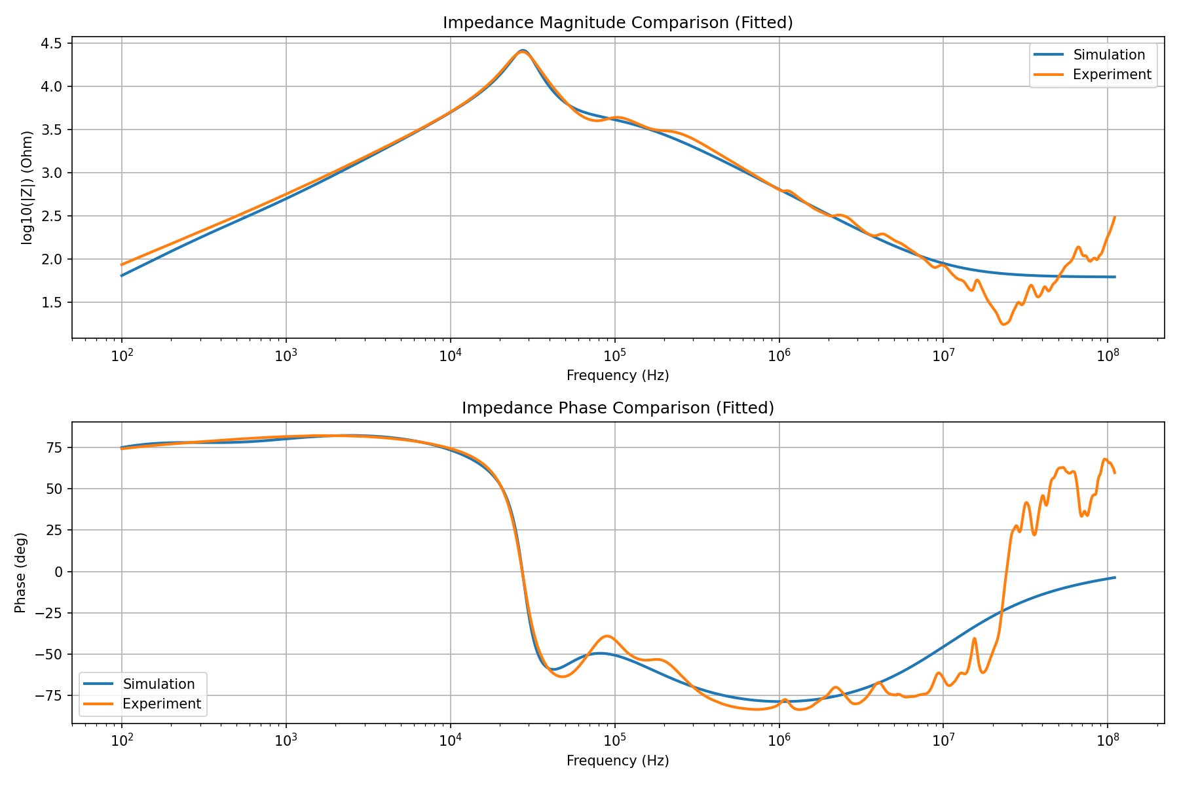
Status of Paper Replication
Replication Result
Core analytical model: successfully reproduced
Parameters match literature values reasonably well
Important Limitation
Ultra-high-frequency region (10⁷–10⁸ Hz): Outside current model validity
Conclusion
Below UHF range → fitting quality is very good

Slide 5
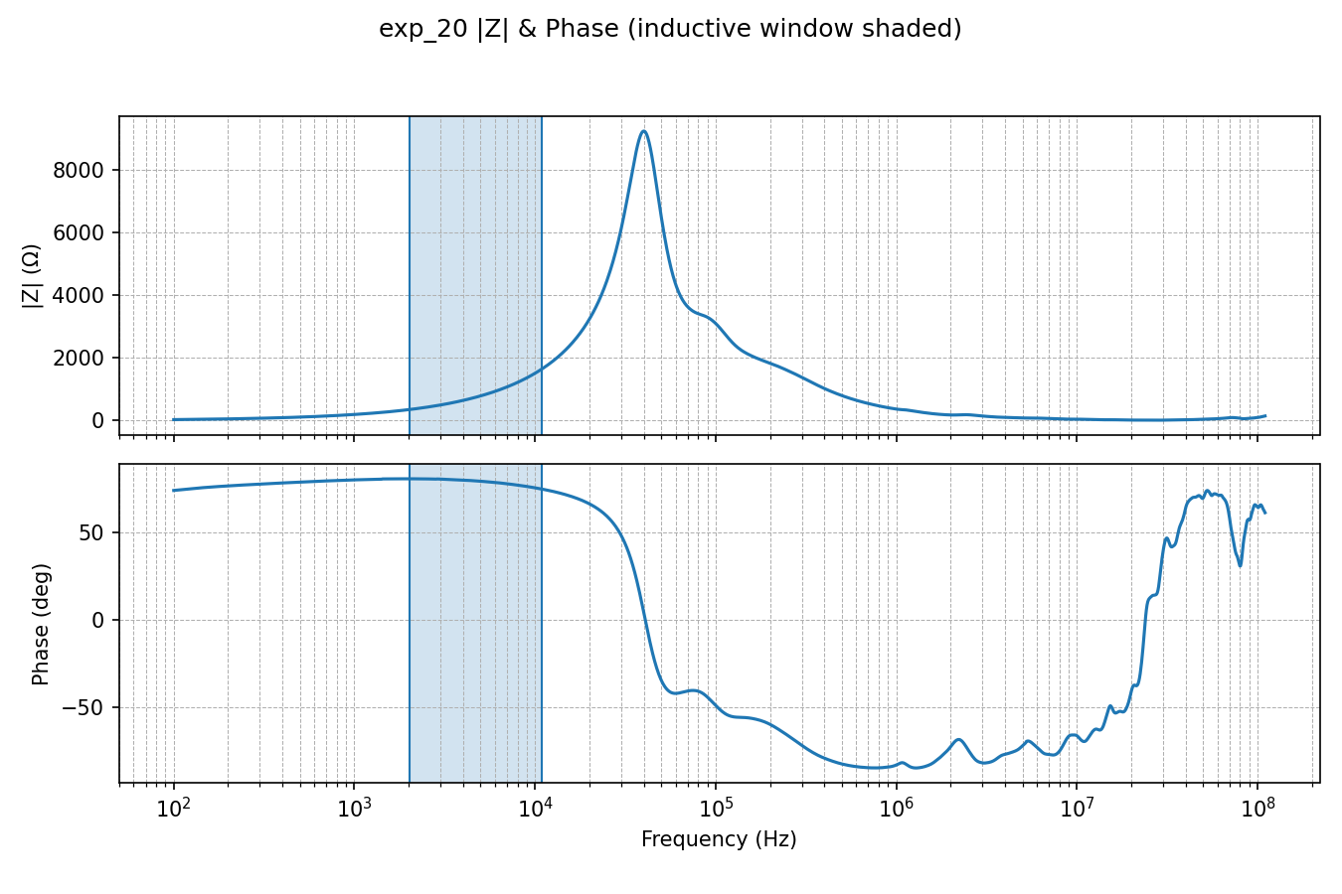
Extraction of Stator Series Leakage Inductance (Lls)
Method Used
Work in mid-frequency range
Identify a reliable inductive plateau
Convert measured port inductance → total leakage inductance Lσ
Assumption from the paper: Leakage equally shared, Lls = Llr = 0.5 · Lσ

Slide 6
Extraction of Stator Series Leakage Inductance (Lls)
Consistency Check
Ratio:
  Leq_Y / Leq_Δ ≈ 3.188
  Expected theoretical range: 3.0 – 3.3 (Conclusion from the paper)
Final Value: Lls = Llr = 2.55 × 10⁻² H
Conclusion
Low-frequency leakage inductance extraction is reliable

Slide 7
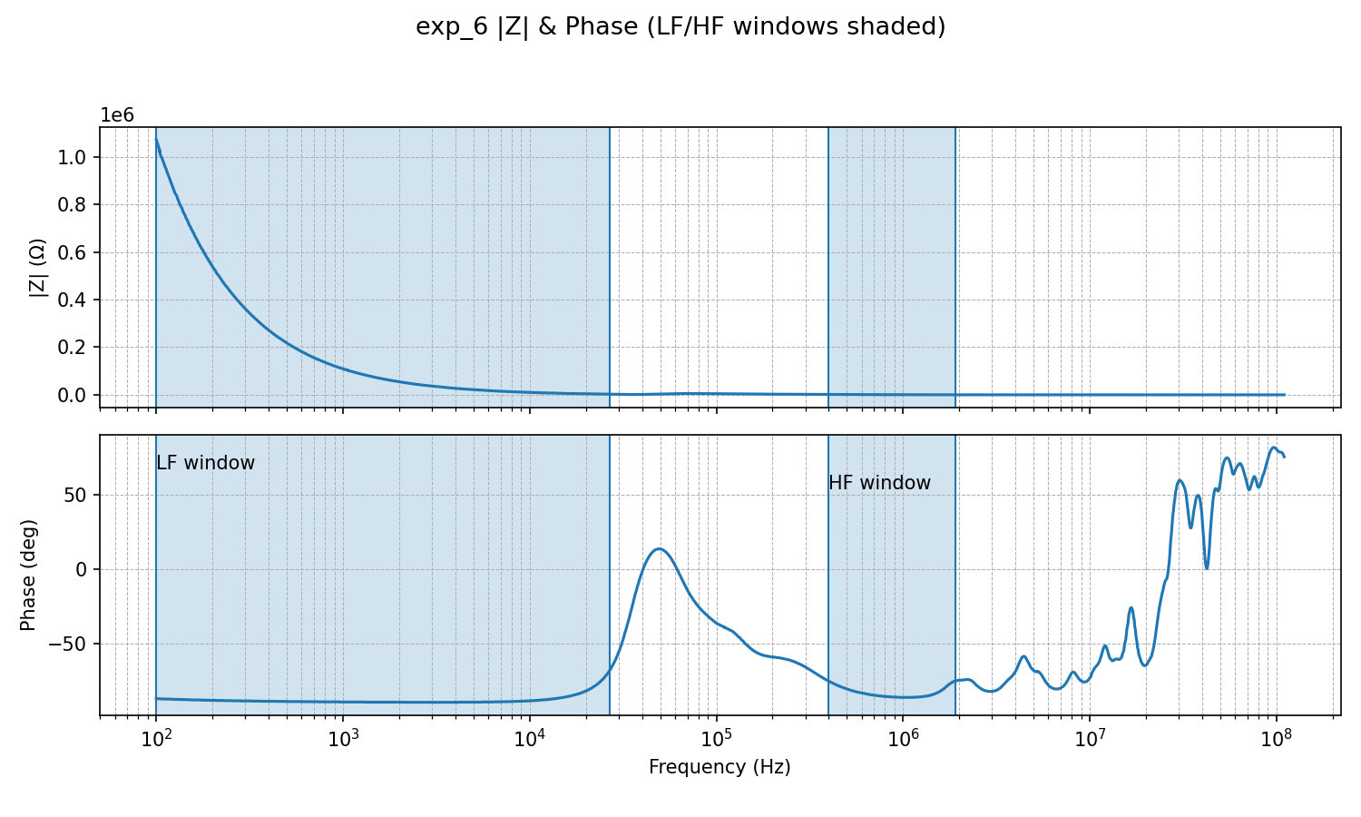
Computing ηLls, Stator first turn leakage inductance
ηLls represents:
  Small fraction of stator leakage
  Located near terminals
Step 1 — Estimating Csf
Sweep impedance vs frequency
Identify capacitive plateaus:
  Before first resonance (LF)
  After first resonance (HF)

Slide 8
Computing ηLls, Stator first turn leakage inductance
Cross-Validation
Single-phase vs Δ-connection
Parallel and series combinations
Observed Ratios
Δ / (2 × #13) ≈ 0.85
Δ / (6 × single-phase) ≈ 0.88
Conclusion
Consistency acceptable
Parameter | Value
Csf_HF | 2.461 × 10⁻¹⁰ F
Csf_LF | 1.516 × 10⁻⁹ F

Slide 9

Computing ηLls, Stator first turn leakage inductance
Cross-Validation
Single-phase vs Δ-connection
Parallel and series combinations
Observed Ratios
Δ / (2 × #13) ≈ 0.85
Δ / (6 × single-phase) ≈ 0.88
Conclusion
Consistency acceptable
Parameter | Value
Csf_HF | 2.461 × 10⁻¹⁰ F
Csf_LF | 1.516 × 10⁻⁹ F
Result: ηLls = 1.7806 × 10⁻² H

Slide 10
Emerging Physical Inconsistency
Key Observation
ηLls ≈ 70% of total Lls
Why This Is a Problem
ηLls should represent only first few turns, very small portion of stator leakage;
This contradicts physical intuition

Slide 11
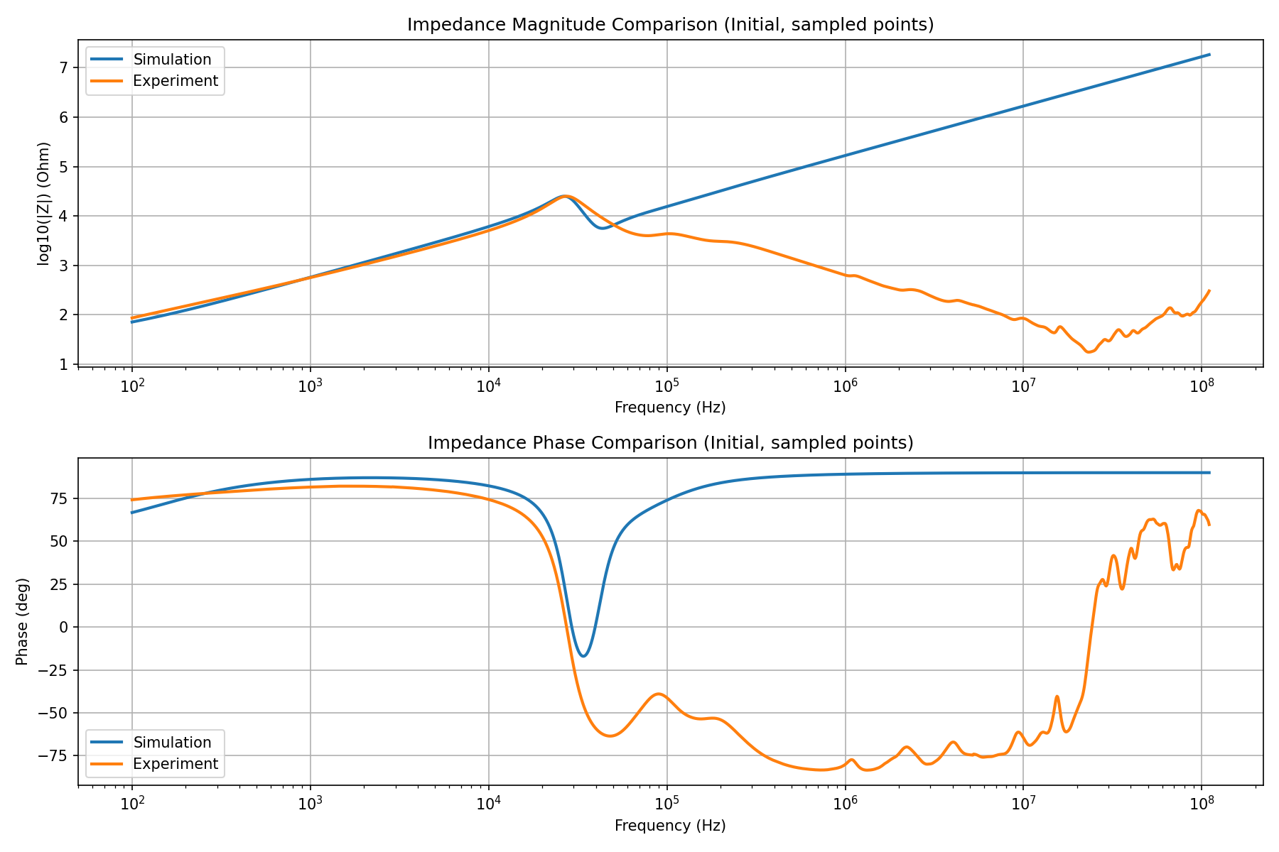
Impact on High-Frequency Simulation
If ηLls is large
Circuit becomes strongly inductive at HF
Impedance magnitude explodes
Phase stays near +90°
Mismatch
Strongly inconsistent with measured data

Slide 12
Empirical Correction Test
Experiment
Reduce ηLls to a much smaller value
Result
HF impedance curve:
  Matches experiment very well
  Both magnitude and phase
Implication
Original formula likely overestimates ηLls

Slide 13
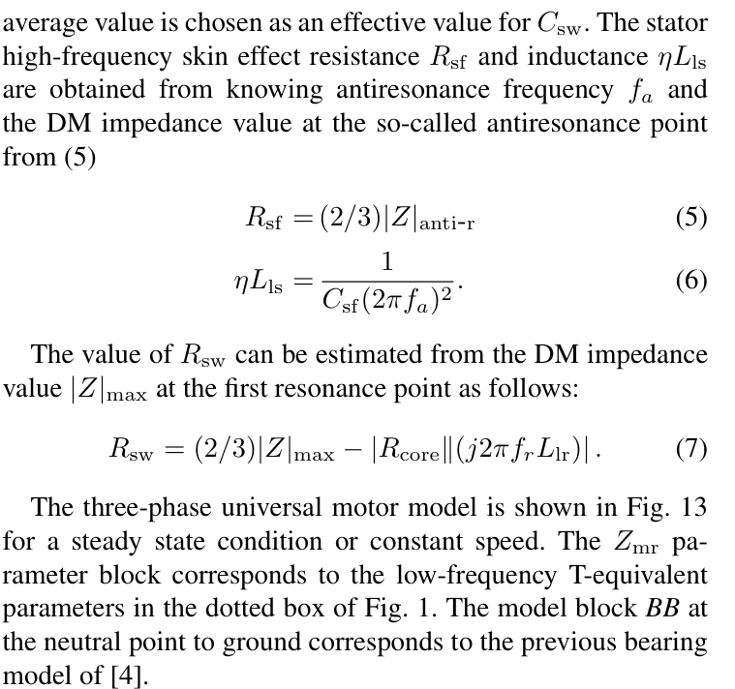
Root Cause Analysis
Observations
Formula depends only on: Csf, fa
Possible Issues
Csf definition ambiguity
fa identification ambiguity
Missing geometric assumptions
Current Hypothesis
Formula is incomplete or context-dependent

Slide 14
Next Steps
Planned Work
Re-derive high-frequency leakage path
Refactor parameter extraction codebase
Improve fitting strategy after model stabilization
Extend model with additional HF branches

Slide 15
add
修饰最后一段关键是加电容，串联？关键是选一个点位，然后算等效电感之后，就可以根据需要的谐振频率来算这个电容的值。当然点位有很多，要看哪个合理，有些都算不出来。然后做出来之后还要多选几组来对比，确认对各种情况差模共模都能胜任。

